Slide 1

Introduction to Deep Learning
Fundamental concepts and applications for a non-technical audience
OÖ
by Onur Özdemir

Slide 2
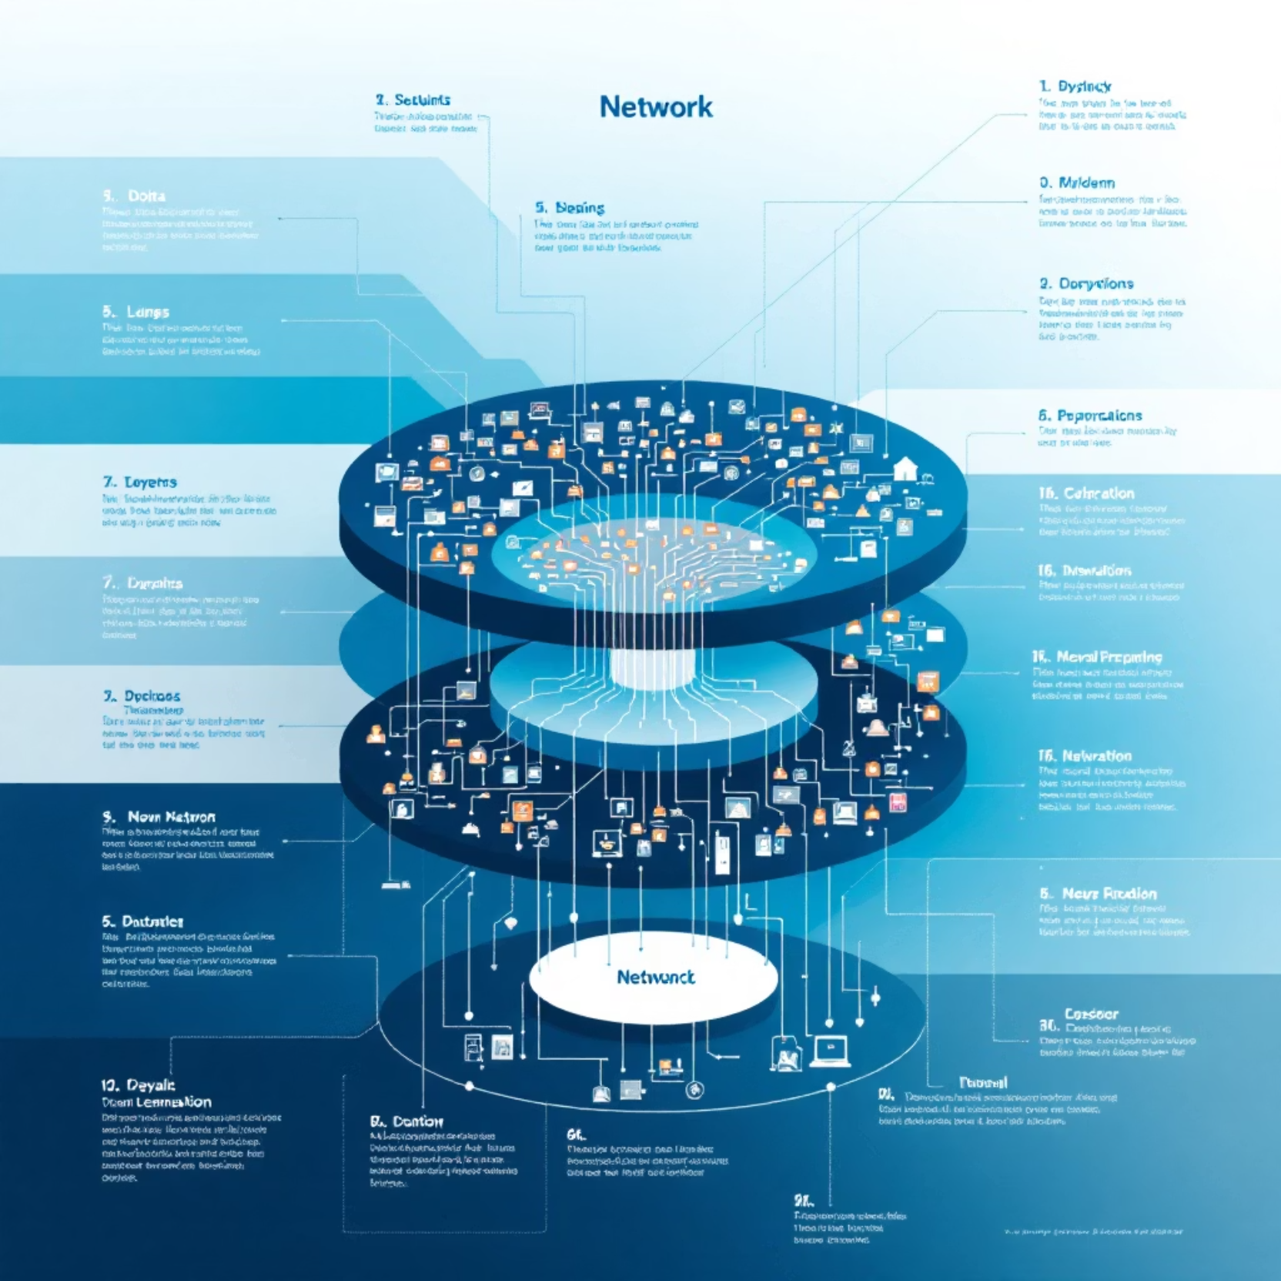
What is Deep Learning?
Deep learning is a branch of artificial intelligence that learns hierarchical representations from data using deep neural networks inspired by the human brain.
Models with three or more layers are considered "deep."
Key characteristic: Features are automatically learned from data, not manually determined.

Slide 3
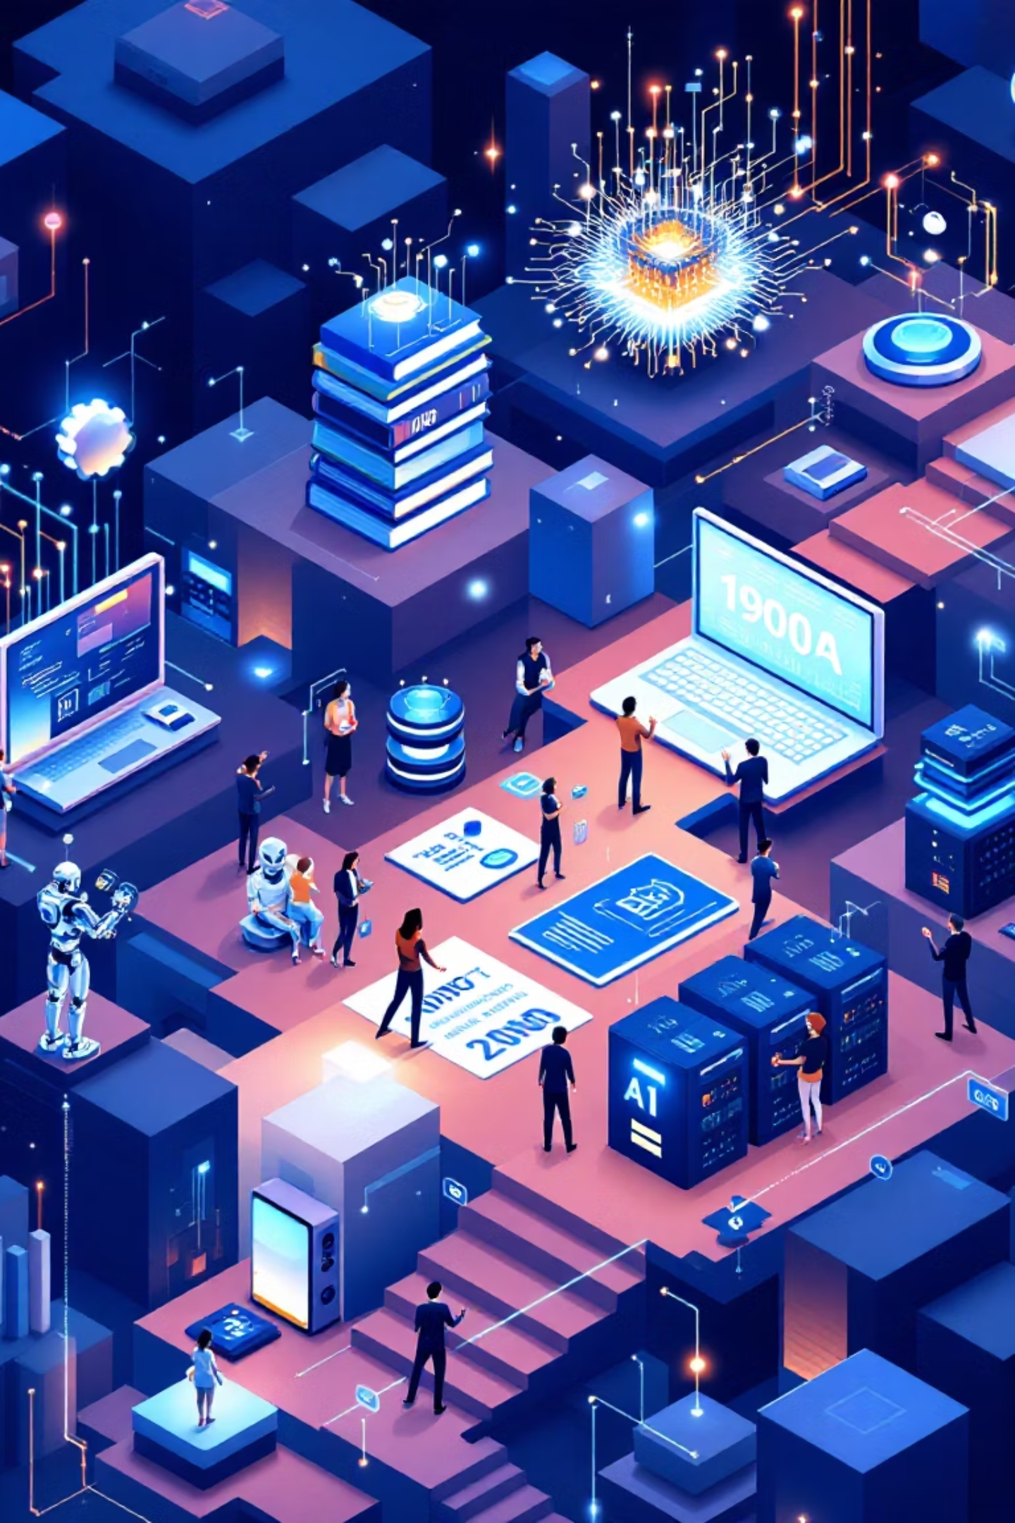
History and Milestones
1
1980s
The first CNN (Convolutional Neural Networks) and LSTM (Long Short-Term Memory) models were introduced. Fundamental concepts were developed, but hardware was insufficient.
2
2012
AlexNet won the ImageNet competition, revolutionizing image classification. It demonstrated the potential of deep learning.
3
2014-2018
GANs (Generative Adversarial Networks) and diffusion models emerged. Realistic image generation became possible.
4
2020 and beyond
Large language models and multimodal systems became widespread. Models like GPT and DALL-E captured public attention.

Slide 4
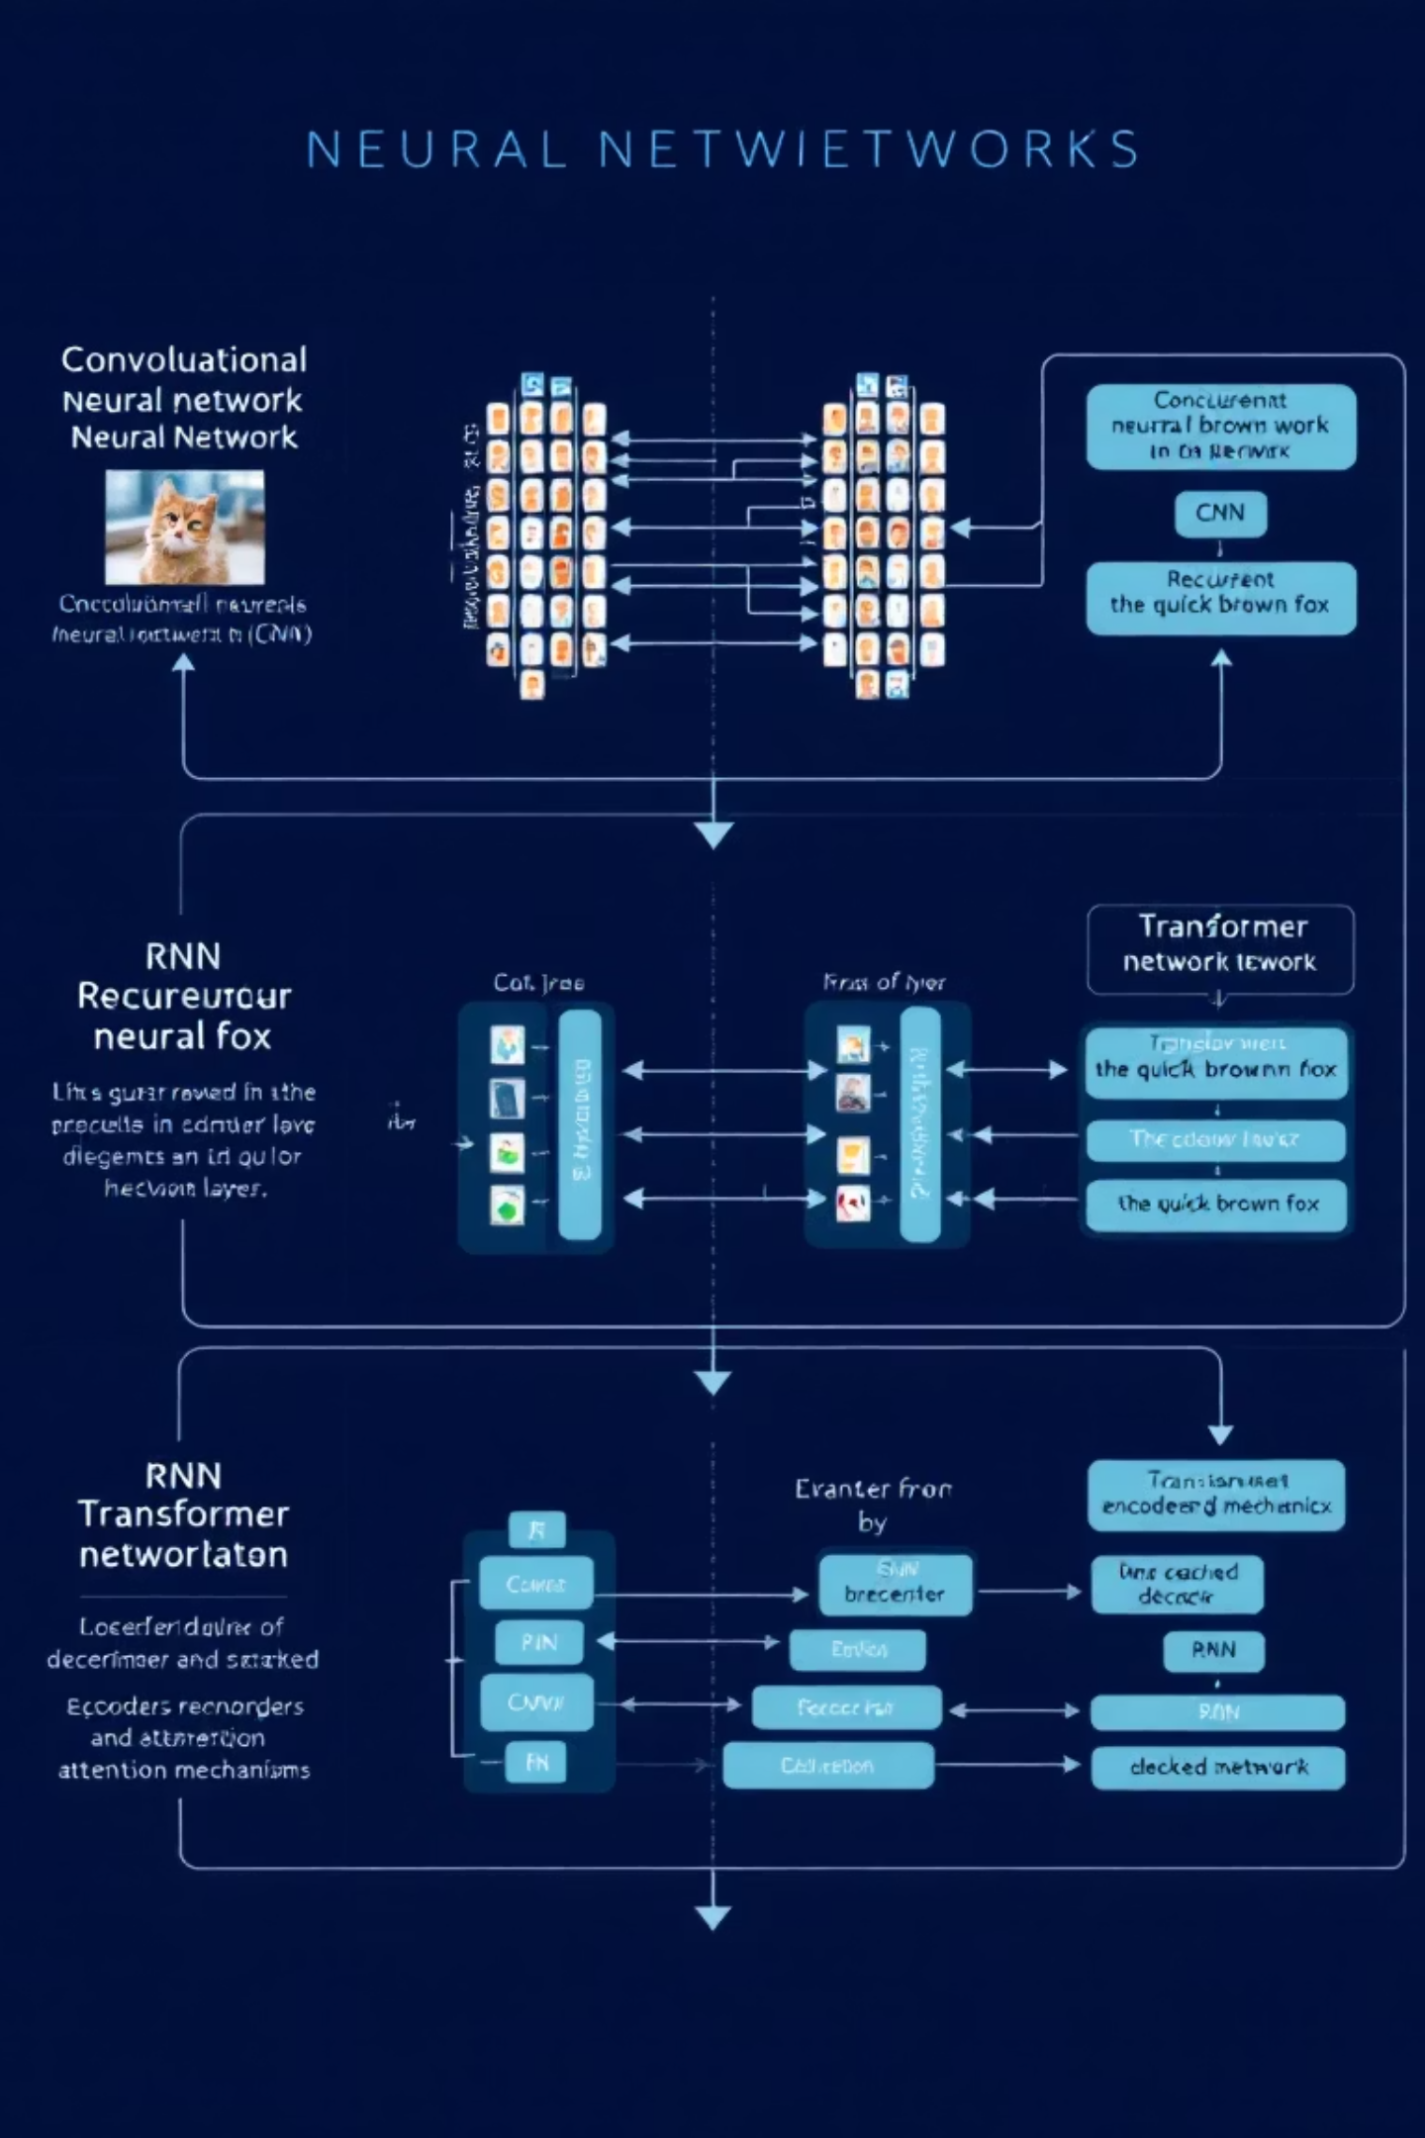

Core Architectures
CNN
RNN / LSTM
Convolutional Neural Networks are used for image processing. They detect visual features using filters. Ideal for face recognition and object detection.
Recurrent Neural Networks and Long Short-Term Memory models are used for time series and sequential data. Effective in text, speech, and music generation.
Transformer
Modern models that use attention mechanisms. Works efficiently with parallel processing capabilities. It is the basis of large language models like ChatGPT.

Slide 5
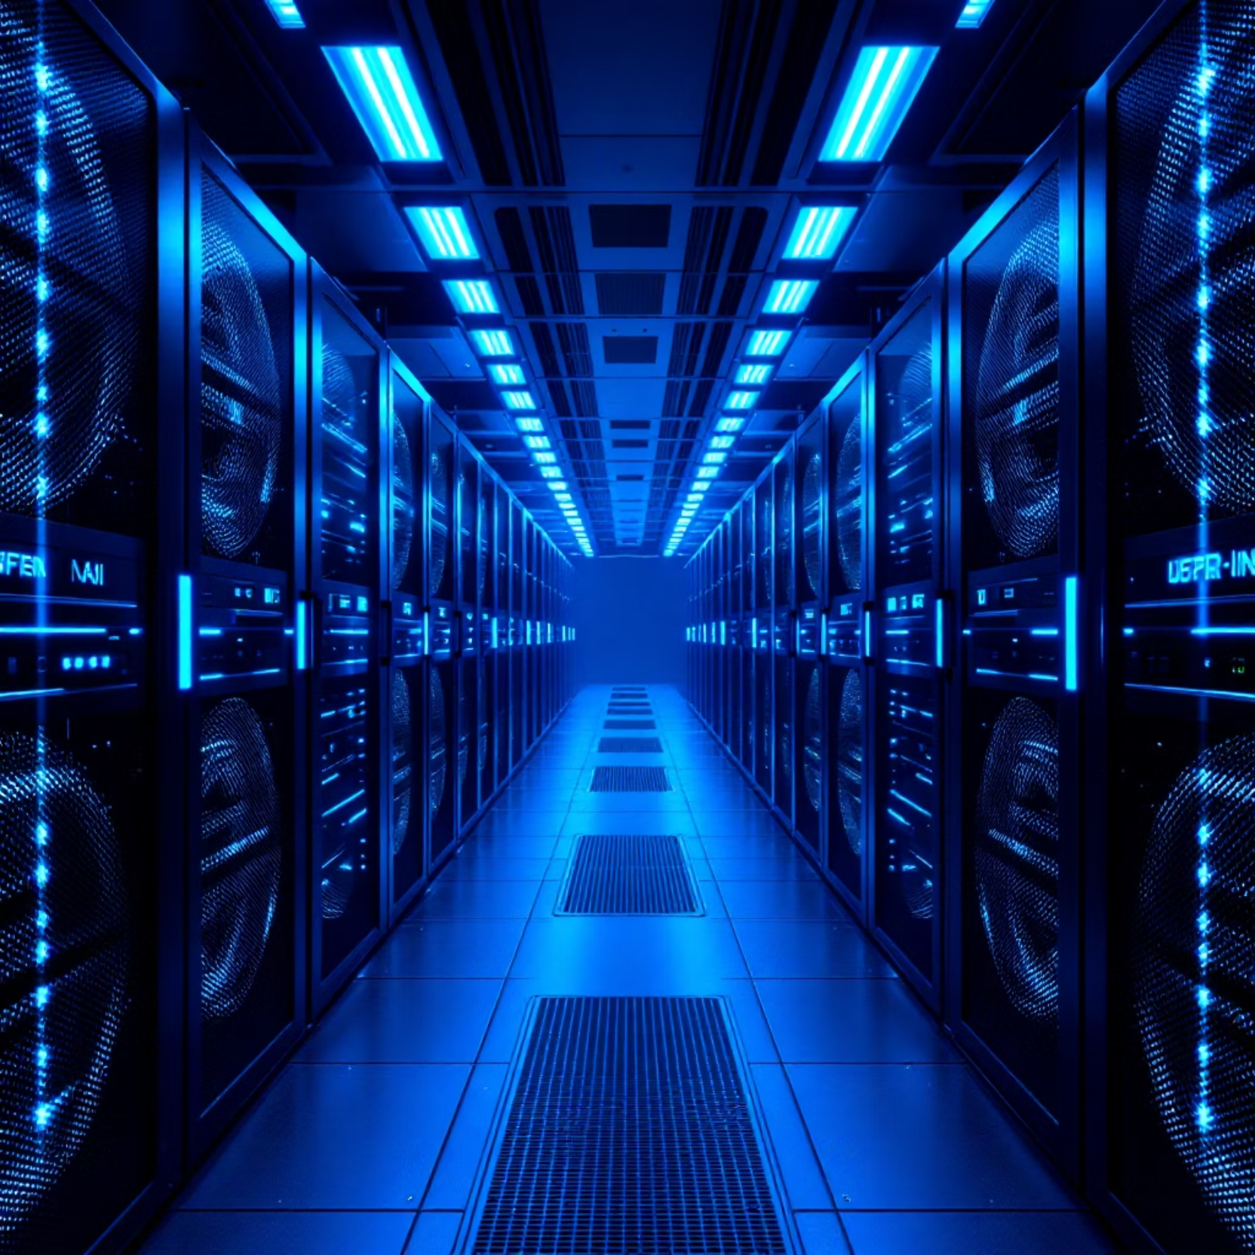
Hardware and Training
Powerful Hardware Requirements
GPUs (Graphics Processing Units) accelerate training
TPUs and NPUs are specially designed chips
Cloud platforms provide high computing power
Training Requirements
Large datasets (millions of examples)
Long training times (days/weeks)
High energy consumption

Slide 6




Applications
Image Recognition
Natural Language Processing
Face recognition systems, object detection, medical image analysis. It is the basis of modern security systems and automatic photo tagging.
1
2
Translation, sentiment analysis, text generation. Used for chatbots, digital assistants, and automatic content creation.
Finance and Science
Medical Applications
Used in areas such as stock market prediction, fraud detection, climate modeling, and protein structure prediction.
4
3
Disease diagnosis, drug discovery, personalized medicine. Used in the analysis of radiology images for cancer detection.

Slide 7
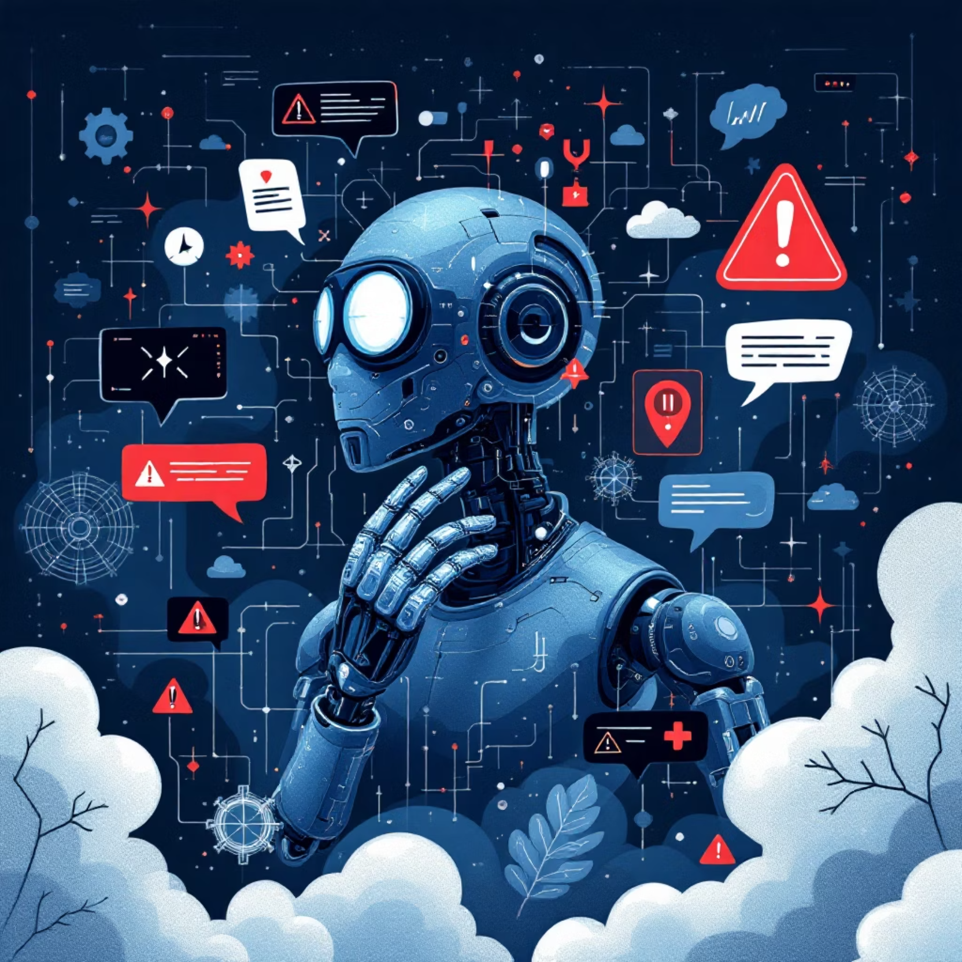
Challenges and Risks
Vulnerable to Adversarial Attacks
Minor alterations can fool models. Poses serious risks for security systems.
Black Box Nature
Difficult to understand how decisions are made. Limits its use in critical areas.
Resource Requirements
Requires massive data and computational power. Creates environmental impact and access inequality.

Slide 8
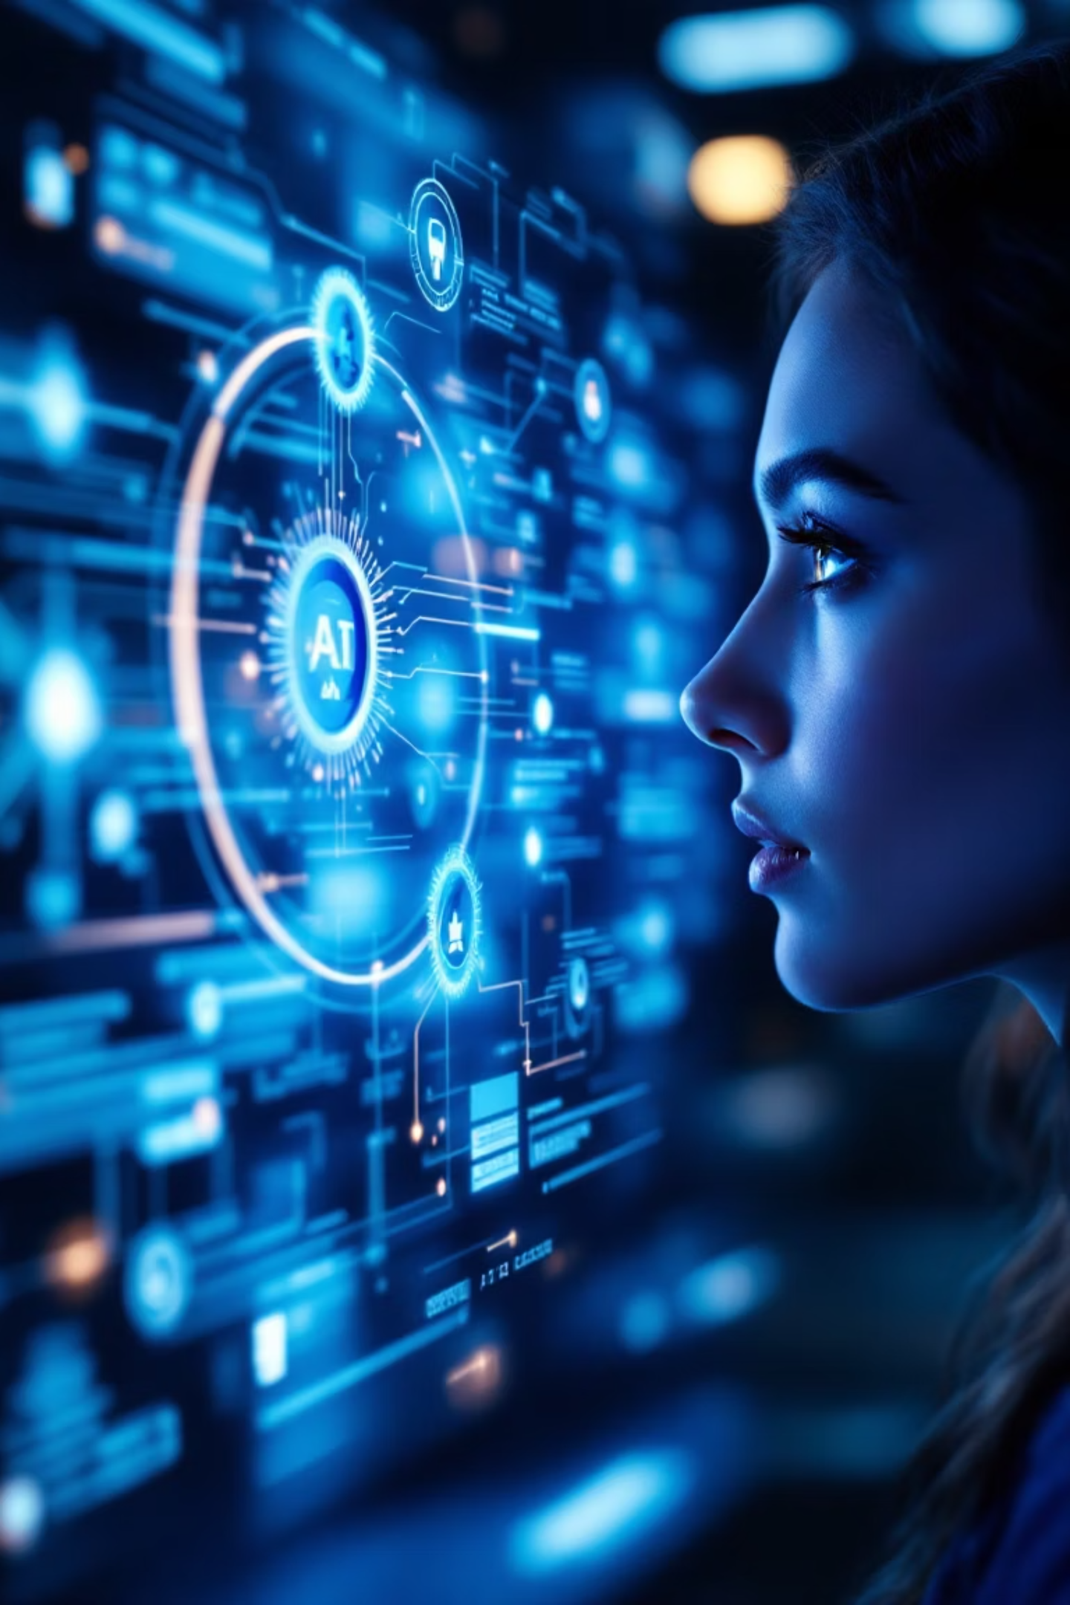
Key Takeaways
Deep learning is the core driving force of AI
It is constantly evolving
New architectures and applications emerge every year. The boundaries are continuously expanding.
Most of the AI advancements we see have been made possible by deep learning.
A balanced approach is necessary
While exploring potential benefits, we must not overlook ethical concerns and risks.
Thank you! Any questions?

